Slide 1
Custom Resource Definitions
events.kabanero.io/v1alpha1
Events
Operator
mediator2
controller/pod
mediator1
controller/pod
External
listener
Create/delete
Message flow

Slide 2

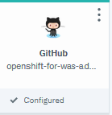

org1
project1
pr-project1-<id>
stack: docker.io/kabanero/nodejs:0.2
Listener 0.3.3
push-project2-<id>
project2
stack: docker.io/kabanero/nodejs:0.3
Webhook
mediator
Listener 1.0.1
pr-project3-<id>
project3
stack: docker.io/kabanero/java-openliberty:1

Slide 3




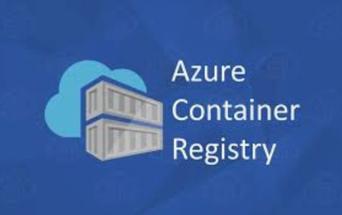
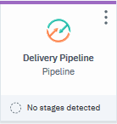

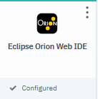

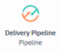
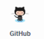


events
events
webhook
Google
publisher
subscriber
sender
listener
app1
event
event
webhook
Container
Registry
Tekton
Tekton

